Slide 1
Multiple Instance Learning with pre-contextual knowledge
Università degli studi di Modena e Reggio Emilia
AI for Bioinformatics
Grandi Andrea (275074)
Vellani Daniele (196186)

Slide 2
Aim of the project
Modify a MIL architecture and see if adding contextual knowledge to it will give better results in WSI classification of tumor images
The additional info is given by a segmentation and analysis tool called Cellpose, working directly on the WSIs

Slide 3
Scientific/Practical Importance

Slide 4
Project workflow
Preprocessing
Segmentation
Feature extraction
BUFFERMIL
Preprocessing: created the various patch using CLAM
Segmentation: Cellpose results aren't enough for the architecture chosen
Feature extraction: DINO model
Integration with pre-existing BUFFERMIL architecture: find a way to use feature extracted

Slide 5
Preprocessing with CLAM

Slide 6
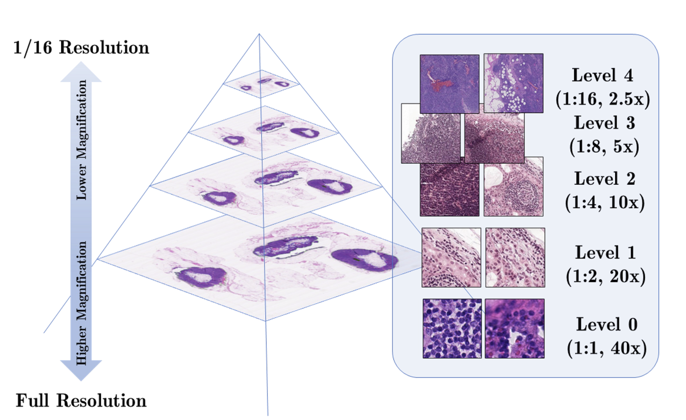
What is a WSI?
Definition: Scanning a complete microscope slide to create a single high-resolution digital file.
Process: Capturing many small high-resolution image tiles and montaging them to create a full image.
Impact: Transforming laboratory workflows by enabling efficient storage, access, analysis, and sharing of digital slides.

Slide 7
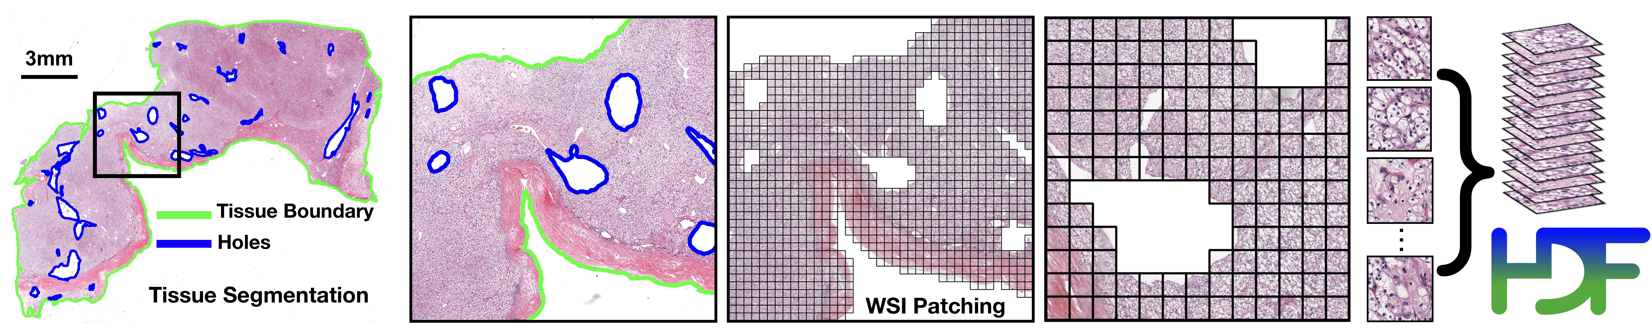
CLAM
Capability: CLAM is a high-throughput and interpretable method for data efficient whole slide image (WSI) classification.
Advantage: CLAM can handle multi-class subtyping problems and adapt to independent test cohorts of WSI resections and biopsies as well as smartphone microscopy images.
Feature: CLAM does not require any ROI extraction or patch-level annotations.

Slide 8
How does CLAM work?
Method Type: Deep-learning-based weakly-supervised method.
Purpose: Accurately classify whole slides by identifying sub-regions of high diagnostic value.
Key Technique: Attention-based learning and instance-level clustering.

Slide 9
How we integrated CLAM in our work
CLAM Integration: Integrated CLAM for image preprocessing, specifically extracting patches from TIF or SVS files.
CLAM Output: Generates three directories (masks, patches, stitches) and a CSV file containing metadata and variables used for patch creation.
Patch Format: Patches are stored in H5 format and converted to JPG for usability.

Slide 10
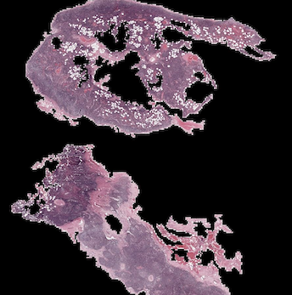
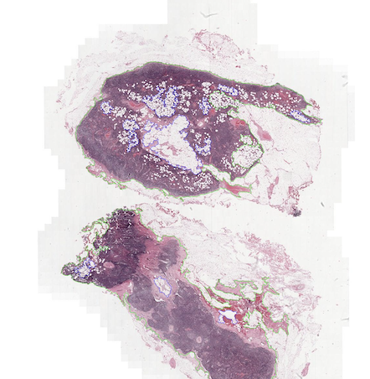
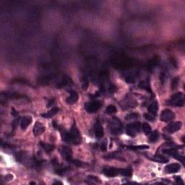
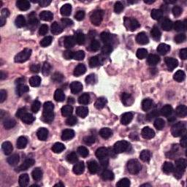
Some examples
Starting from the slide, CLAM generates the stitches, masks and patches

Slide 11
Feature Extraction

Slide 12
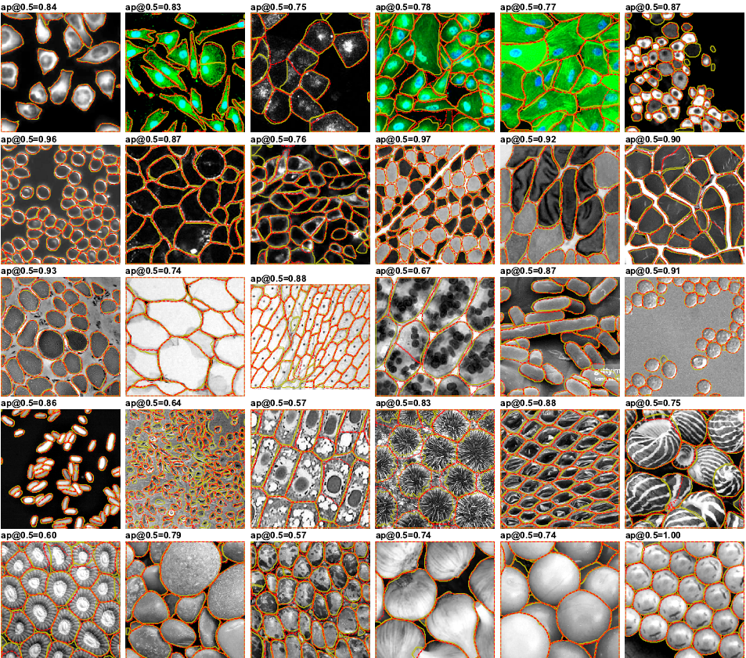
What is Cellpose?
Convenience: segmentation algorithm which performs on wide range of image types out-of-the-box
No need for tuning: doesn't need any retraining or parameter adjustments
Well trained: training done using a large dataset of cells images

Slide 13
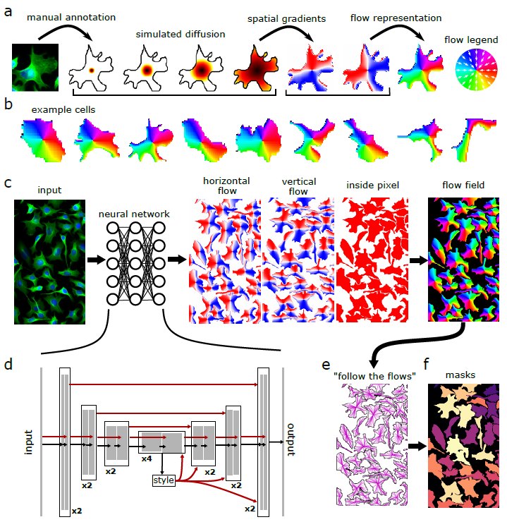
How does Cellpose work?
Method Type: Basic deep neural network design based on the general U-net architecture
Purpose: Doing segmentation on a wide range of images (not only for medical purposes)
Key Technique: Transforming images to be predicted directly by a neural network using a heat source and giving energy to every mask.

Slide 14
The importance of Cellpose
Need of segmentation: the aim of the project is to add contextual features, similar to a human eye helping the BufferMIL
Cellpose output: segmented images with good accuracy masks around cells
Integration: something more is needed, but this is the first step to add visual features to the standard architecture

Slide 15
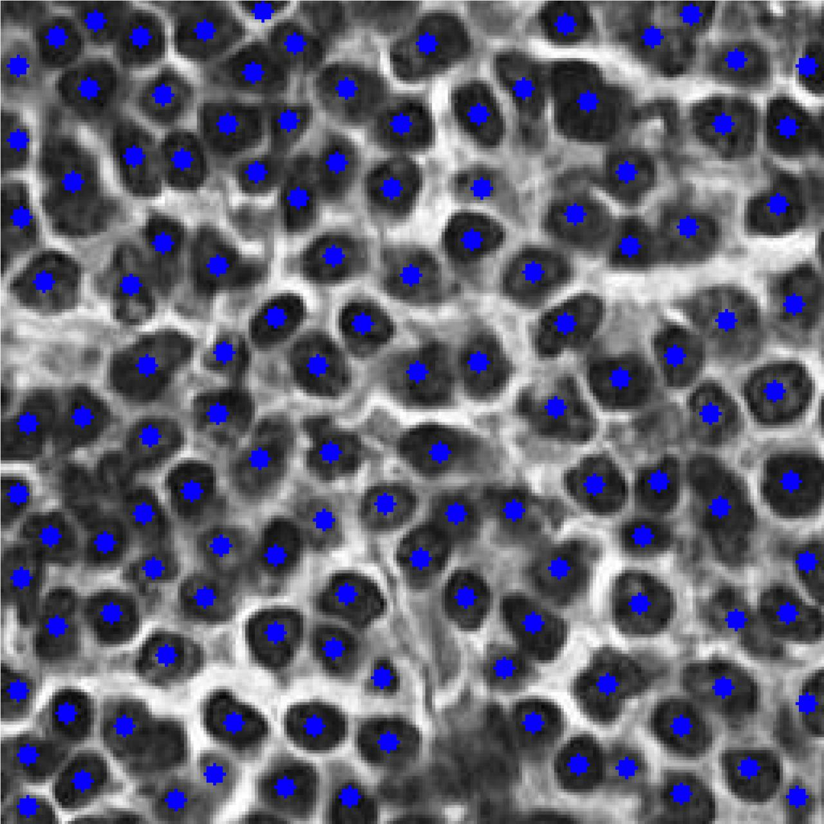
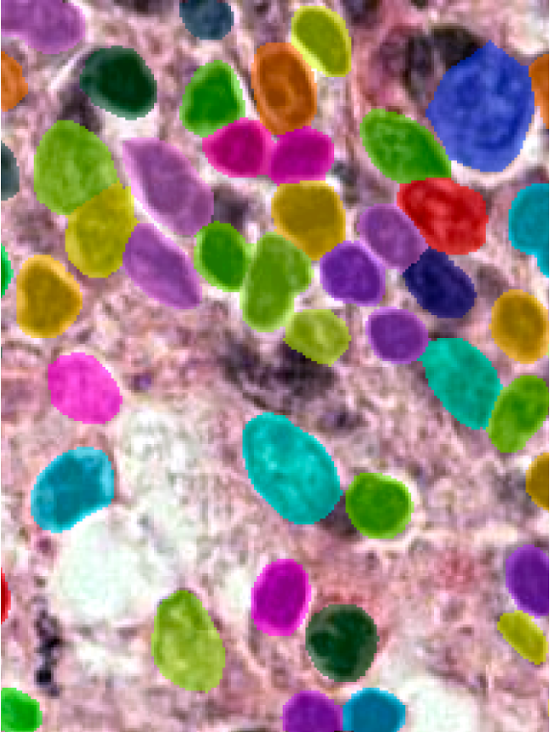
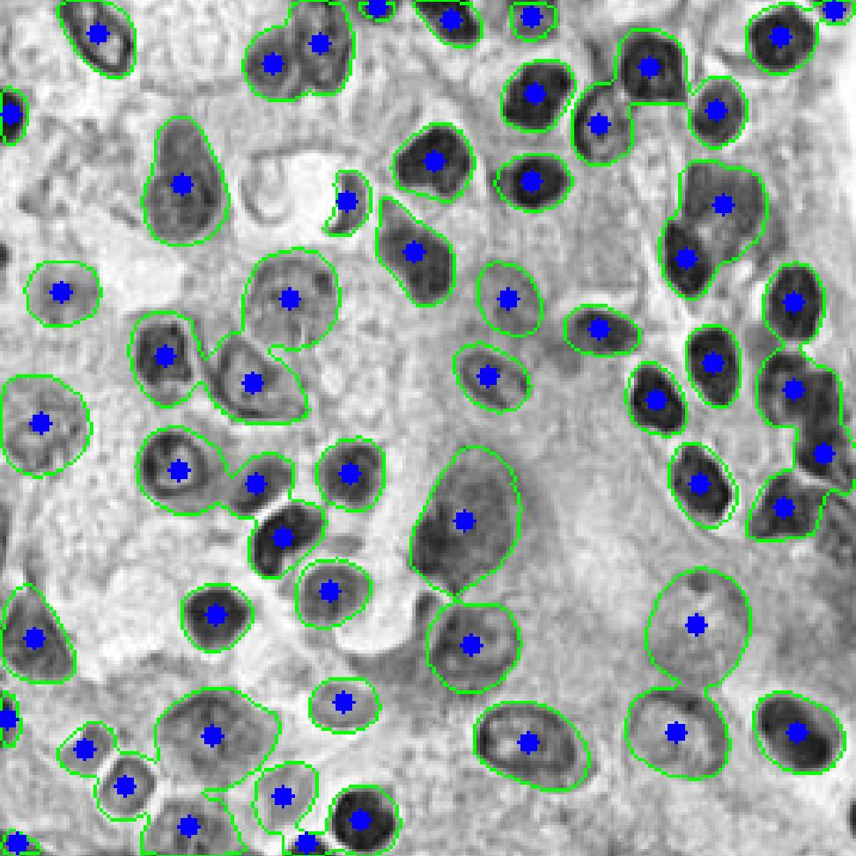
Results with Cellpose
Segmented images obtained on the dataset

Slide 16
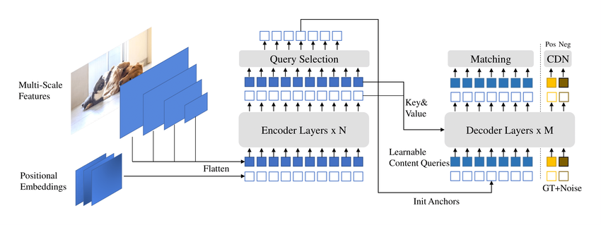
What is DINO and how does it work?
Description: self-supervised method used for feature extraction in images, based on ViT
Output: returns the embeddings and the adjacency matrix
Conversion: results need a format change in .pt

Slide 17
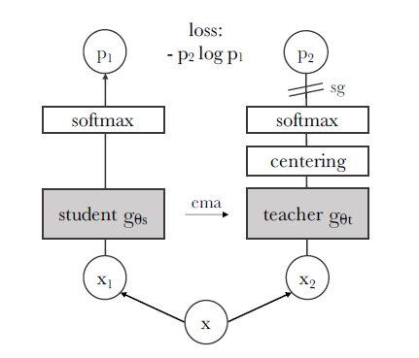
Why DINO?
DINO is a powerful model and it's self-supervised. This means that it can learn without labels
When CLAM creates the bag of patches, it has the label for the WSI and the single patch doesn't maintain it
Cellpose output need to be explained to be used
Works with the student-teacher architecture.

Slide 18
Original BufferMIL and our custom model

Slide 19
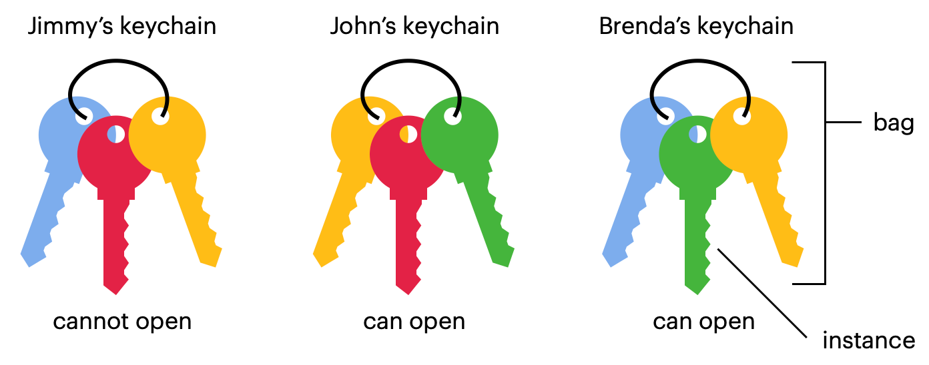
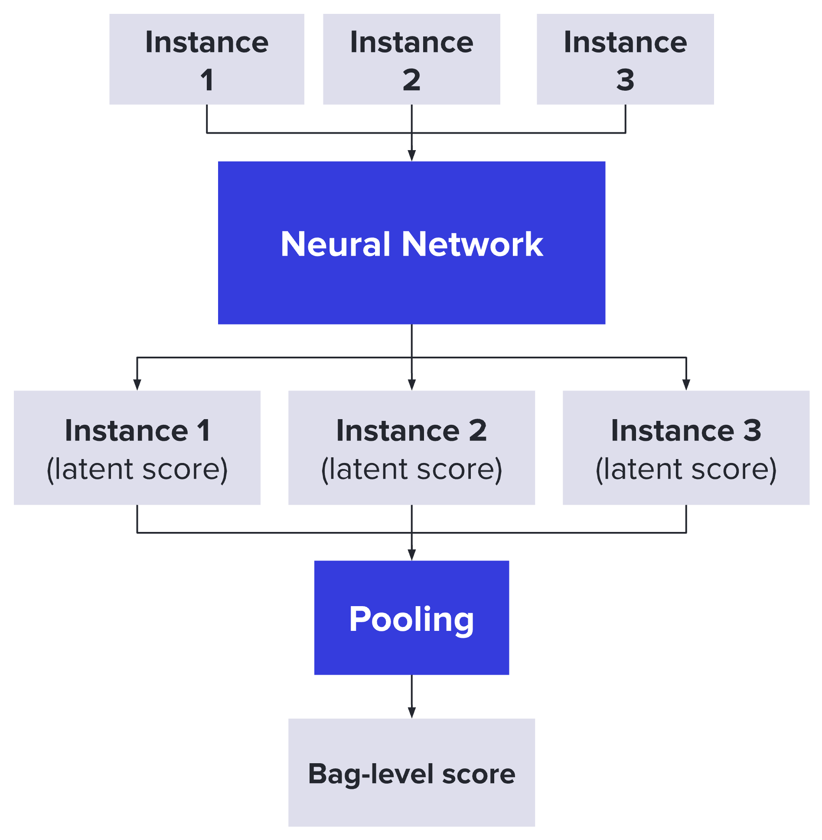
What is Multiple Instance Learning?
MIL is a weakly supervised approach in machine learning that works with labeled bags each of them containing some instances
It's a very useful architecture when the data are too difficult to work on (WSI)
Each patch is considered singularly in an instance-level classifier (usually a NN), then they're all combined together to obtain a bag-level score

Slide 20
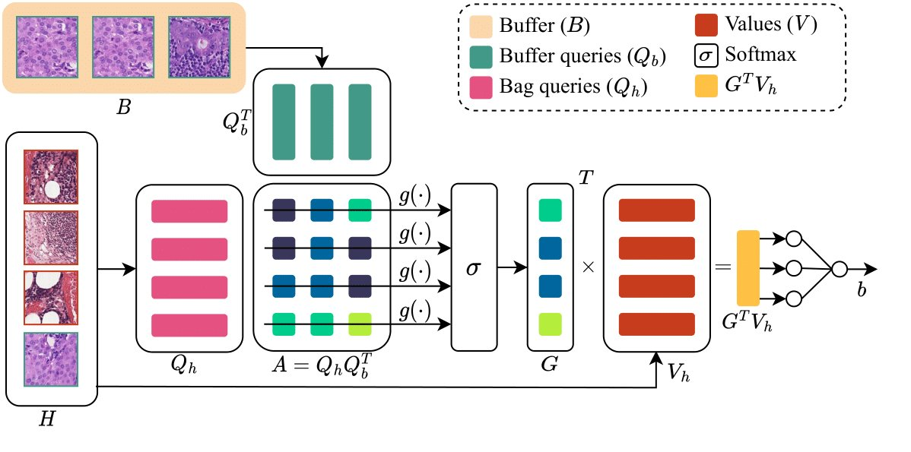
BufferMIL architecture
Description: MIL architecture used for WSI classification
Peculiarity: stores all the most significant instances of each disease-positive slide in a buffer
Attention mechanism: compare the instances against the buffer to find the most critical ones

Slide 21
How can we modify the model?
The idea was simply to add the information gained from the extractor part as an additional information for the buffer
In order to do that, our algorithm uses the extraction results to modify the attention matrix and the weights by concatenation of the new embedding with the pre-existing one

Slide 22
Experiment results
Custom Model
Dataset | Accuracy | AUC
CAMELYON16 | 0.85185 ± 0.010 | 0.91209 ± 0.008
TCGA | 0.80654 ± 0.011 | 0.83345 ± 0.009
Accuracy and AUC (area under curve) obtained on datasets CAMELYON16 and TCGA
Parameters settings
Learning rate: 0.001
Cellpose model: cyto3
BufferMIL aggregation type: mean
BuffmerMIL ntop: 10
Classic BufferMIL
Dataset | Accuracy | AUC
CAMELYON16 | 0.89 ± 0.012 | 0.92857 ± 0.006
TCGA | 0.84989 ± 0.013 | 0.85643 ± 0.007

Slide 23
Conclusions
Experiments show the accuracy level we obtained is pretty high but there are problems with data and noise
Future developments should focus on reducing redundancy and noisy data
Results obtained are a steppingstone for future improvements

Slide 24
Thanks for your attention!
Università degli studi di Modena e Reggio Emilia​
AI for Bioinformatics
​
Grandi Andrea (275074) ​
Vellani Daniele (196186)

